Slide 1
TBOX-19MC
Minh Pham

Slide 2
Agenda:
Overview of project architecture & Module features
Feature: generating Encryption Key
Feature: sending SMS messages
Actors that send SMS messages
SMS message format
HLD sequence
Encryption
Log view
Feature: receiving SMS messages
Actors that send SMS messages
SMS message format
HLD sequence
decryption
Log view

Slide 3
Please see more details at: http://collab.lge.com/main/display/~minh.pham/5.+TBOX-19MC

Slide 4
Overview of project architecture & Module features

Slide 5
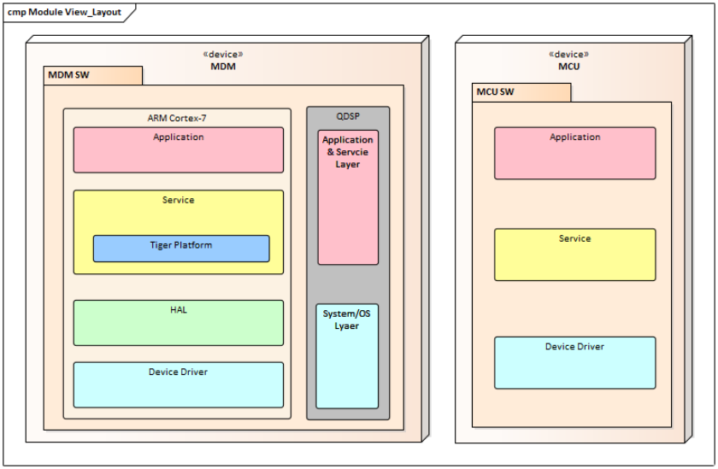
Project components

Slide 6
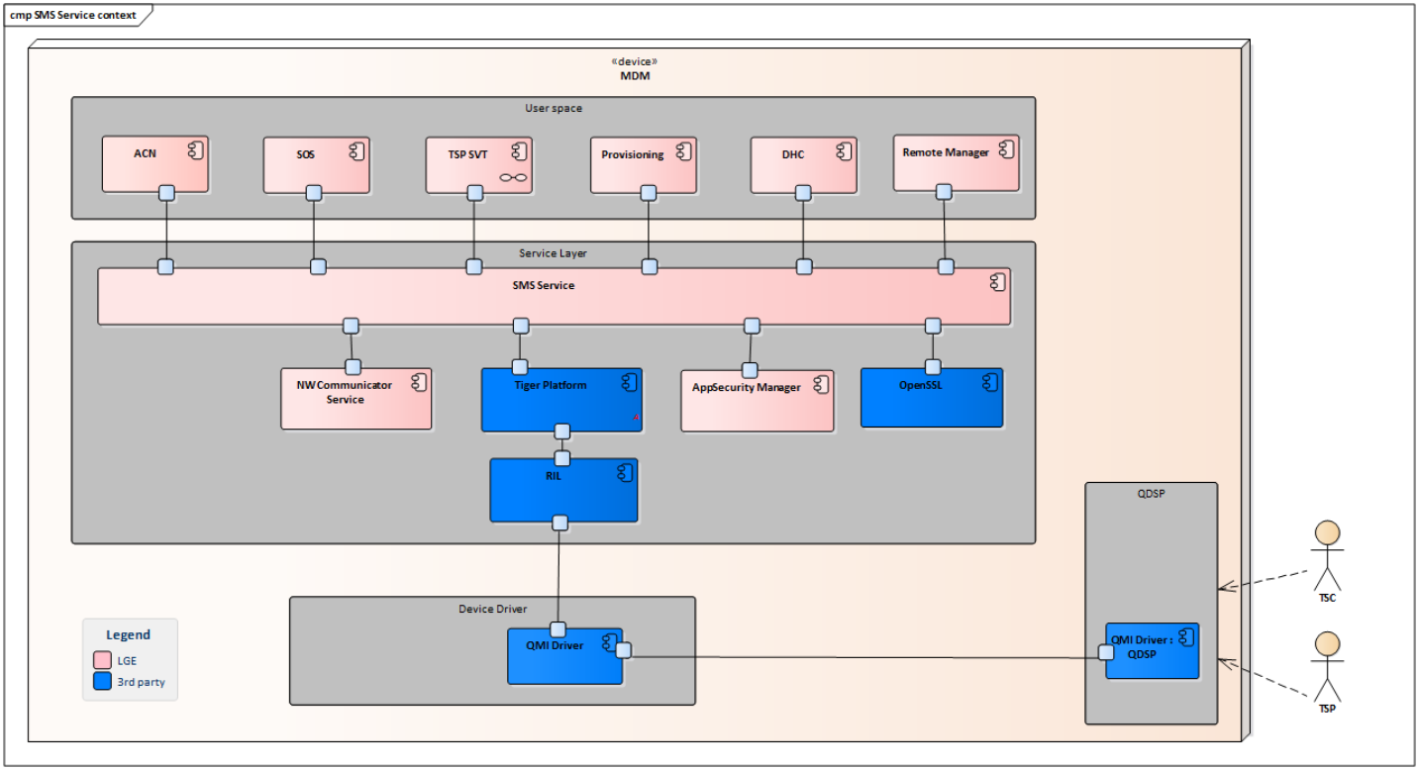
SMS Service context
TSC: Telematic Service Provider
TSP: Toyota Smart Center

Slide 7
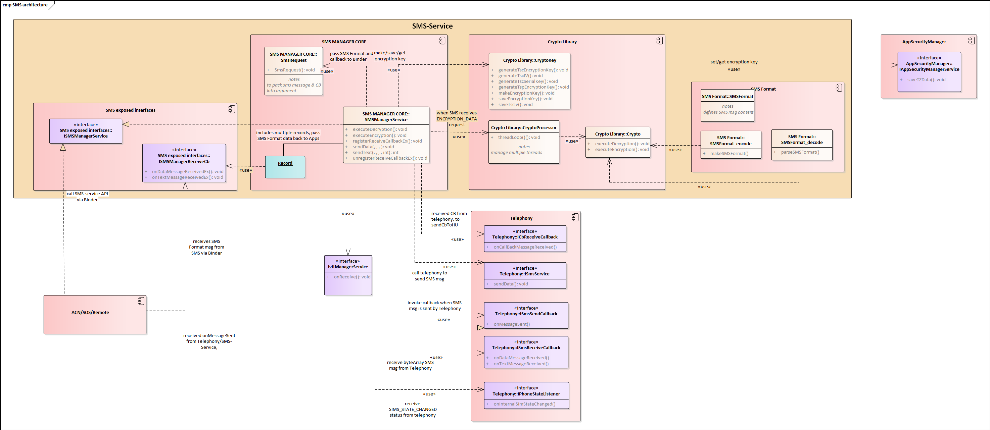
Sms-Service Architecture

Slide 8
Interfaces
More details on: http://collab.lge.com/main/display/~minh.pham/1.+Overall
Declared by | Interface Name | Description | APIs | APIs on Bn side are implemented by | Usage
SMS-Service | ISMSManagerService | provides API to implement module features | sendDataEx/sendTextEx executeEncryption/Decryption registerReceiveCallbackEx/ | SMSManagerService | other apps (ACN/SOS) create an instance of sms-service other apps (ACN/SOS) calls the APIs to perform services
Sms-Service | ISMSManagerReceiveCb | deliveres decrypted SMS message in the format of <SMSFormatData> to apps | onDataMessageReceivedEx onTextMessageReceivedEx | ACN/SOS | apps create a SMSManagerReceiveCb that inherits BnSmsManagerReceiveCb apps implement function onDataMessageReceivedEx() and onTextMessageReceivedEx Sms_service receives sms message from Telephony, decrypts it, wraps the msg into SmsDataFormat, and delivers the msg to app ==> see Receive Msg sequence

Slide 9
Interfaces
Declared by | Interface Name | Description | APIs | APIs on Bn side are implemented by | Usage
Telephony | IPhoneStateListener | notifies Sms_service if phone status is SIM_STATE_READY or SIM_STATE_LOADED | onInternalSimStateChanged | SMSManagerService | SMS-Service creates an instance of telephony. telephony pass phone status to PhoneStateListerner => onInternalSimStateChanged is invoked => SMS service get new IMEI, EUICCI
Telephony | ISmsService | allows Sms_service to invoke telephony api to send sms messages. | sendData( destAddr, scAddr, destPort, bytes, length, <ISmsSendCallback> &callback, cbMsgId, retryNum) sendText | Telephony | Sms-Service start ISmsService to invoke ISmsService API After encrypting sms message and wraping up the message in ByteArray, Sms-service requests sendData/sendText api

Slide 10
Interfaces
Declared by | Interface Name | Description | APIs | APIs on Bn side are implemented by | Usage
Telephony | ISmsReceiverCallback | allows telephony to deliver message to Sms-Service. | onDataMessageReceived(bytes, length, origAddr) onTextMessageReceived(bytes, origAddr) | SMSManagerService | Sms_Service defines class SmsServiceCallback that inherits BnSmsReceiveCallback Sms_Service implements onDataMessageReceived and onTextMessageReceived. ==> see Receive Msg sequence
Telephony | ISmsSendCallback | delivered status of send SMS message request to apps | onMessageSent(status, error_code, msgId) | ACN/SOS | apps create a SmsSendCallback that inherits BnSmsSendrCallback. apps implement function onMessageSent(). apps pass callback (reference to an instance of SmsSendCallback to SmsManagerService::SendDataEx(...) upon successful delivery of SMS message (after ACK) ==> onMessageSent is invoked. ==> see sendMsg sequence

Slide 11
Some “utility classes”
Class | Description | API | Usage
OperationFactor | sends error code to VifCANContainer | sendOperationFactor(const uint16_t operationFactor) | OperationFactor constructor create a service/instance of IVifManagerService When receiving messages from Telephony, if time to process message is >600s, send error code to NV Communication manager (VifManagerService mOpFactor->sendOperationFactor(OPERATION_FACTOR_INVALID_SMS_DETECTION);
SmsRequest | wraps sms message and relevant data to "argument" | SmsRequest constructor | Sms-Service defines SendRequestAsyn function. sendRequestAsync(const int32_t command, const android::sp<mindroid::Bundle>& argument, const android::sp<ISmsSendCallback>& cb) argument wraps up SmsFormatData (sms message), dest address, source addres, destination port, msgId to be sent through binder. argument is android bundle. Notes: why use android bundle instead of parcel ? Ref: https://justforchangesake.wordpress.com/2014/05/07/android-bundle-vs-parcel-vs-message/#:~:text=Bundle%20was%20created%20to%20replace,more%20complex%20serialization%20of%20classes.
SmsDataFormat | defines fields to be included in SMS messages sent/received by Sms-service
ByteArray | Maniputate bytestream data of sms message to send to /Receive from Telephony

Slide 12
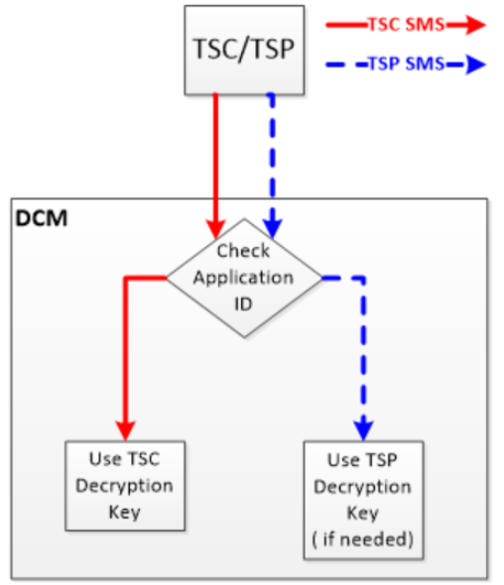
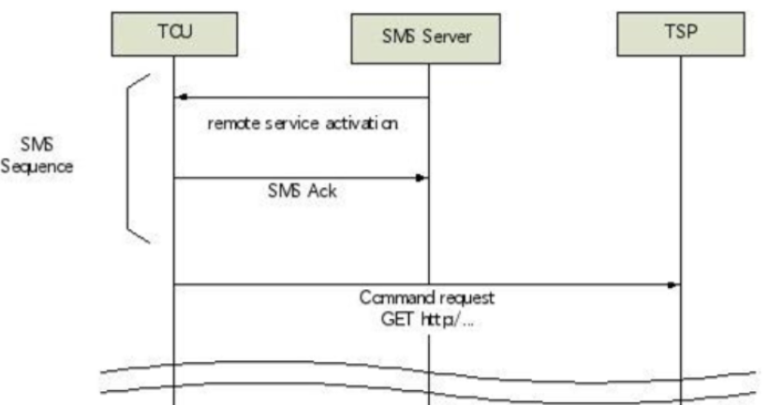
Main Features
Main features | Sub Features | Link | Description
Sending/Receiving SMS | SMS communication operation To TSP and to TSC | SMS Communication RS-14371853 (lge.com)
 | SMS connection flow requirement | SMS Connection Flow RS-14324792 (lge.com)
 | SMS format requirements - Address section (for receiving msg) | SMS Message Format (Address Section) RS-14316701 (lge.com)
 | SMS format requirements - Command section (for receiving msg) | SMS Message Format (Command Section) RS-14316702 (lge.com)
 | SMS format requirements - Data section (for receiving msg) | Data section (Max 58 byte) RS-14324591 (lge.com)
 | other minor RS.....

Slide 13
Main Features
Encrypting/Decrypting SMS | Data part of SMS has to encrypted before sending and decrypted after receiving | (US)SMS Encryption Requirements RS-14320458 (lge.com) (US)SMS Encryption Requirements | The “TSP Payload” section in the SMS format will be encrypted by the TSP The SMS will be encrypted using AES-256 algorithm. AES mode of operation – CBC Encryption key length shall be 32 bytes Encryption key – To be provided later by TSP
 | Generate Master Key for US market | http://vscb.lge.com:8080/cb/issue/14324704
 | Generate DCM (Serial) Key | http://vscb.lge.com:8080/cb/issue/14325076
 | Generate Encryption Key from DCM and Master key | http://vscb.lge.com:8080/cb/issue/14325077
 | Generate IV | http://vscb.lge.com:8080/cb/issue/14325078
 | Generate "Final" Encryption Key Part= Time + Encryption key | http://vscb.lge.com:8080/cb/issue/14324989
 | Generate Encryption Key for Message Part= Time + Encryption key (for receiving message) | http://vscb.lge.com:8080/cb/issue/14324990
 | The format of data part has Encryption Key Part + Message Part (for receiving message) | http://vscb.lge.com:8080/cb/issue/14324987

Slide 14
Generating Encryption Key
Generating key at boot up or after sim state changed

Slide 15
Generating Key
Key Type | Description | Types/Variants | Usage | API
DCM serial key | Input : eUICCID Harsh by SHA256 Output: serial key stored as private variable in SMS Manager Service |  | used for creating master key | generateTscSerialKey(\n COMMERCIAL_MODE,\n mTSCSerialKey)
"Master Key" | has many types | ALPHA_KEY = 0, BETA_KEY, GAMMA_KEY, MASTER_KEY_GROUP_END,
TSC Encryption Key | Input : Master Key, Serial Key Hash by SHA256 XOR between Master Key & Serial Key shuffled Output: TSC Encryption Key stored in App Security Manager | TSC_SMS_KEY | used to encrypt/decrypte SMS message to TSC | generateTscEncryptionKey(mTSCSerialKey)
TSP Encryption Key | Input : IMEI + UEICCID shuffled encrypted by SHA256 Output: TSP Encryption Key stored in App Security Manager | TSP_SMS_KEY | used to encrypt/decrypte SMS message to TSC | generateTspEncryptionKey(COMMERCIAL_MODE);
Initial Vector | Input : IMEI changed IMEI Hash by SHA256 Output: Initial Vector stored in App Security Manager | TSC_KEY_IV |  | generateTscIV(COMMERCIAL_MODE)

Slide 16
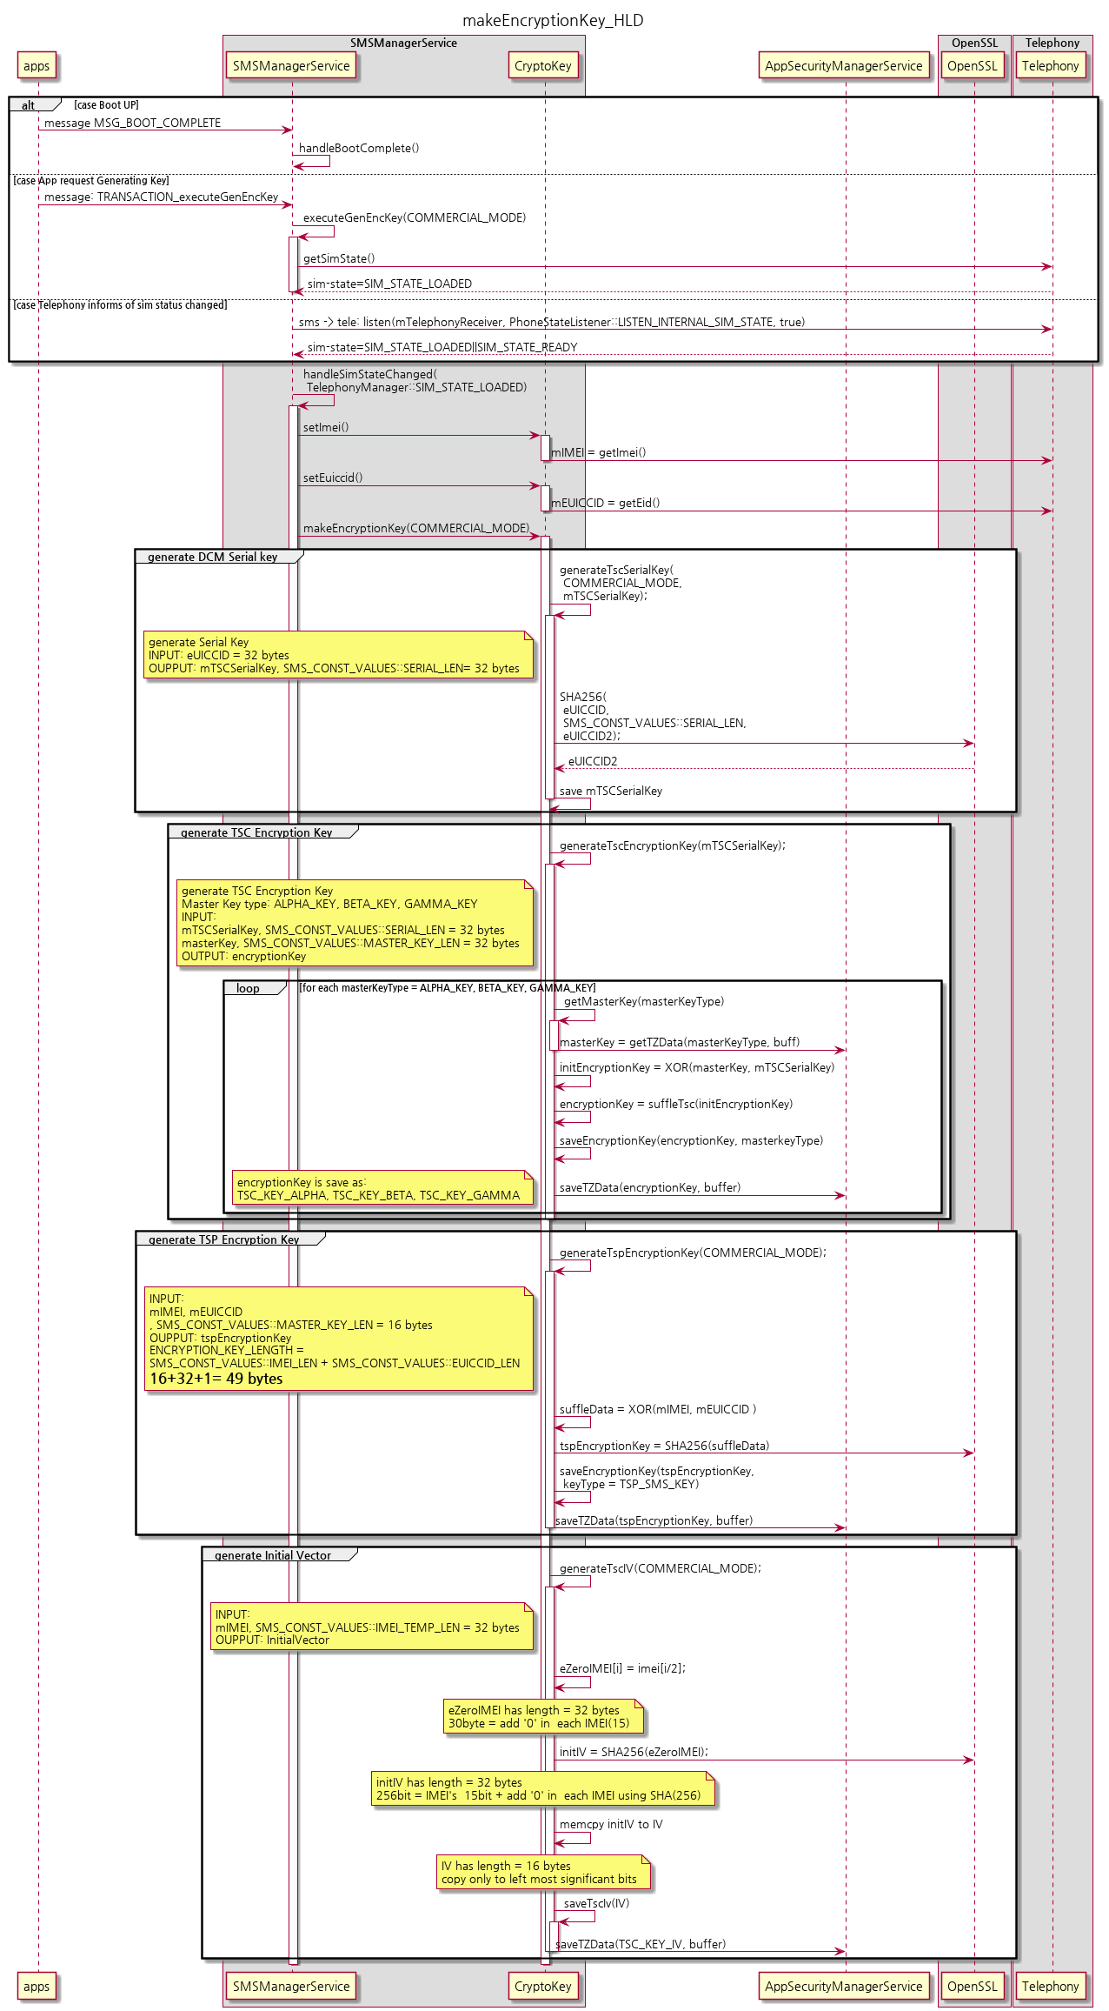
HLD sequence for Generating Keys
Note: better view at http://collab.lge.com/main/display/~minh.pham/2.+Feature+Encryption
INPUT: triggering events
OUTPUT: saved TSC_SMS_KEY, TSP_SMS_KEY, TSC_IV_KEY
RETURN: void
ACTION:
Get imei, euiccid from telephony
Generate tsc serial key from imei, euiccid
Generate tsc encryption key from tsc serial key + master key
Generate tsp encryption key from imei, euiccid key
Generate tsc IV key from imei

Slide 17
Sending Message
Sending message by request of SOS, ACN, or other apps.

Slide 18
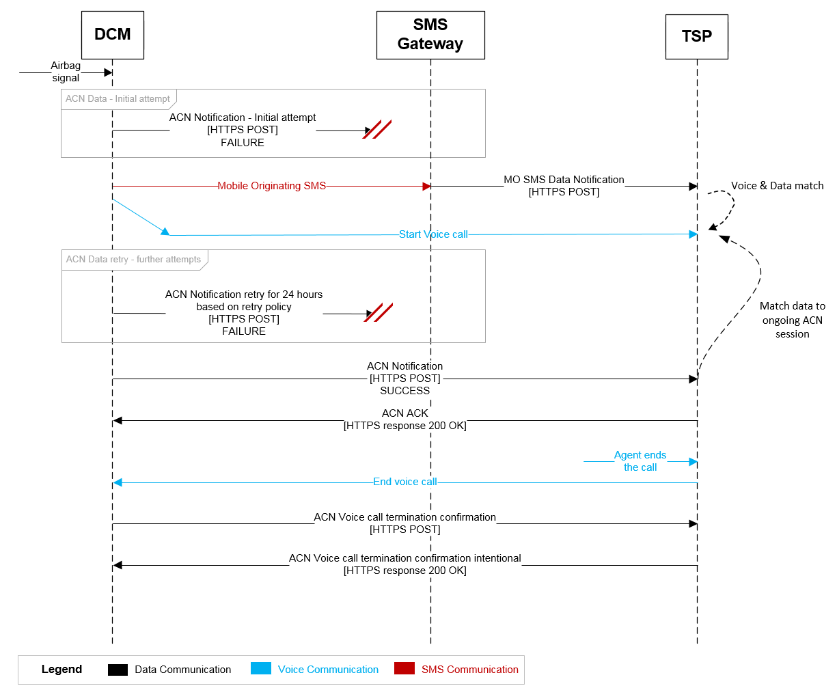
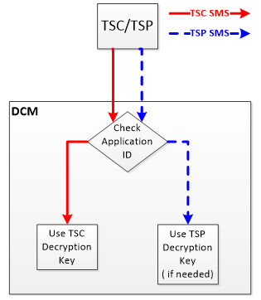
Actors that request SMS to send messages
CAN, SOS, and other apps could request SMS to send messages to TSP server (NA server, requires different encryption)
Other apps could request SMS to send SMS messages to TSC server
Basic SMS communication requirement:

Slide 19
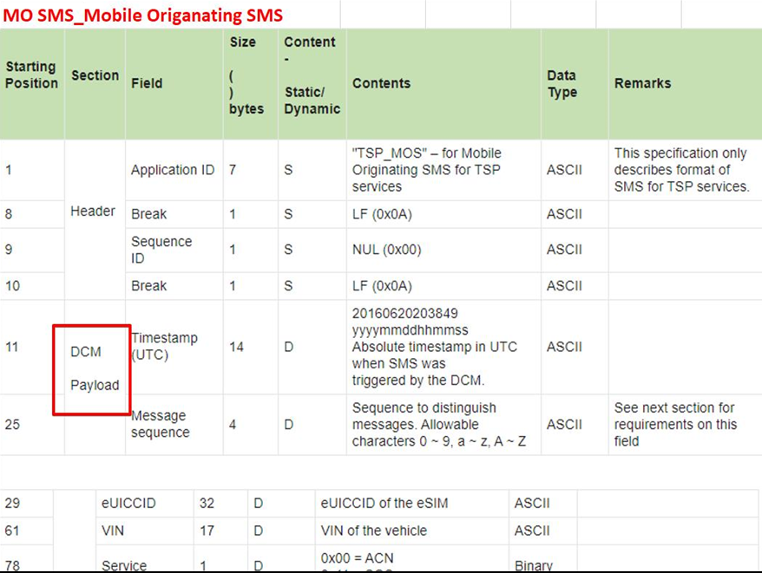
SMS Format for sent messages
RS: http://vscb.lge.com:8080/cb/issue/13219958

Slide 20
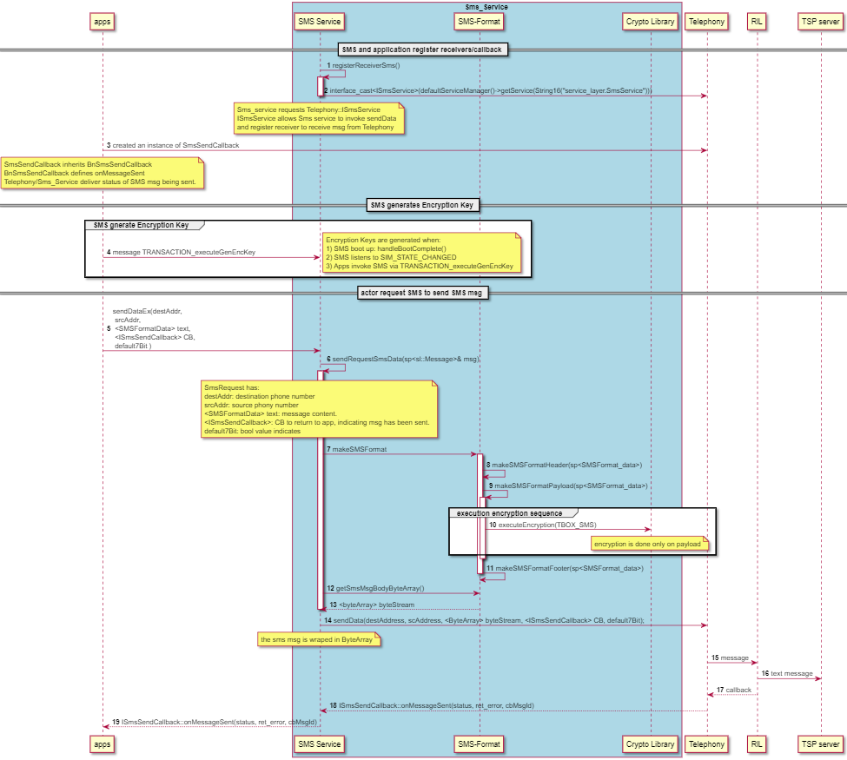
Send Text Message HLD
INPUT:
const char* srcAddr, desAddr, port
const android::sp<SMSFormatData>& iSmsData
const android::sp<ISmsSendCallback>& callback
const uint32_t size
const int32_t cbMsgId
OUTPUT:
const uint8_t *bytes
RETURN:
error
Callback->onMessageSent()
ACTION:
Call SMS-Format to make header, payload, footer.
Call Crypto to perform encryption on payload
Pass int_8t* *byte to telephony

Slide 21
Step 1: How applications deliver SMS and request to SMS-Service
apps create an instance of SMS-Service
defaultServiceManager()->addService(String16(SMSManagerService::getServiceName()), new ServiceStub(“service_layer.ISMSManagerService”));
Type | Data Structure | Description
Input | const android::sp<SMSFormatData>& iSmsData | a plain text message with predefined fields
 | const android::sp<ISmsSendCallback>& callback | callback
 | const char* srcAddr, desAddr, port | Destination, source, destination port
 | const int32_t cbMsgId | Message ID
Output | const uint8_t *bytes | has encrypted sms message with length =
Return | sp<ISmsSendCallback> callback →onMessageSent(status, errorCode, msgID) | the implementation of onMessageSent is at the receiving app side

Slide 22
Step 3: How applications receive callback after sending SMS:
apps create a class that inherits Telephony::BnSmsSendService, and implement onMessagesent Function
apps create in instance of the class
apps pass receiver into ISMSManagerService::sendDataEx/sendTextEx when requesting to send sms message
Telephony/Sms-Service returns send sms message result to apps via callback(status, error_t, MsgId)

Slide 23
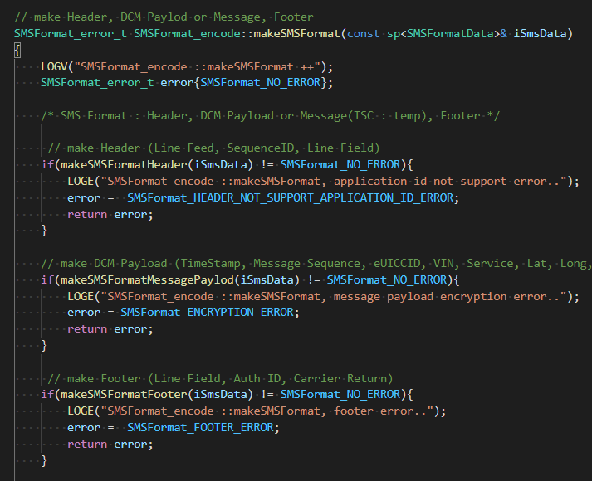
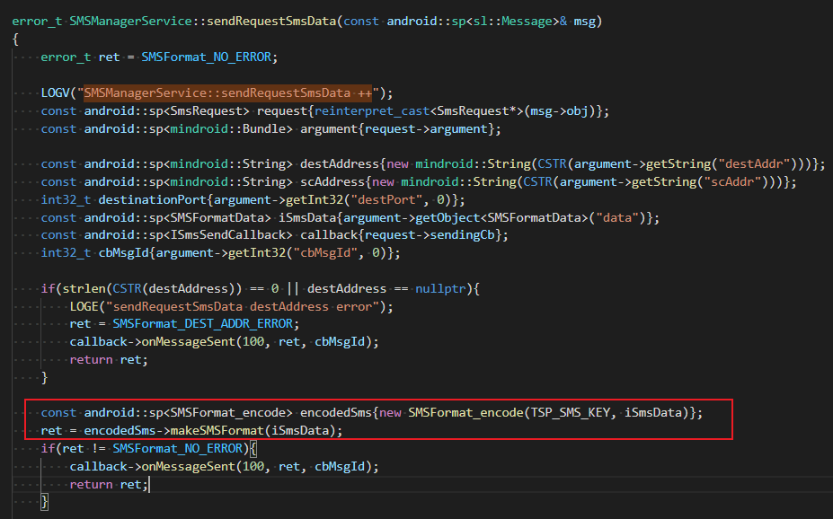
Step 7: Sending and Making SMS Format for sent messages
 | SMS_HEADER_LENGTH | SMS_MESSAGE_DCM_PAYLOAD_LENGTH | SMS_FOOTER_LENGTH
TSP message to send to TSP server | 10 bytes | 96 bytes | 7 bytes

Slide 24
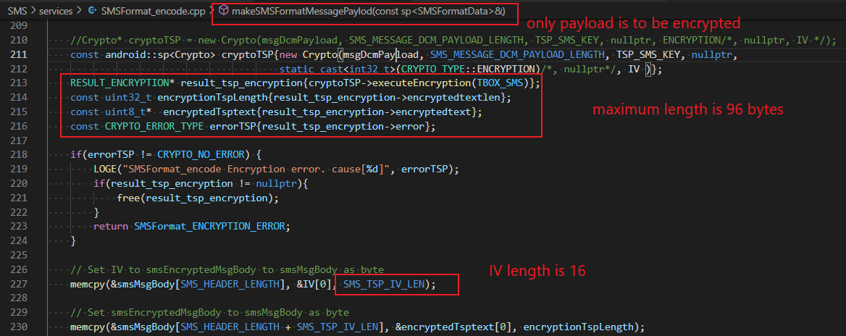
Step 10: Encrypting SMS messages
RS: http://vscb.lge.com:8080/cb/issue/13219967
The following screenshot details the makeSMSFormatMessagePayload function.

Slide 25
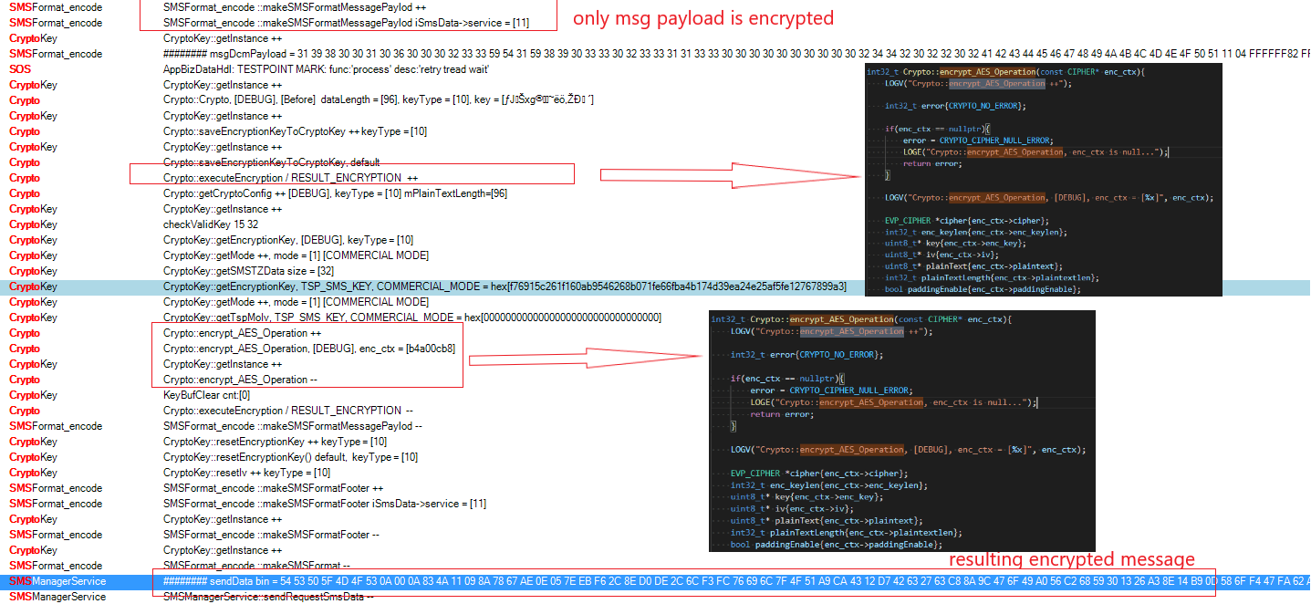
Log Reading
Sample test case: http://vscb.lge.com:8080/cb/item/18820995
The following screenshot details encryption process and log output of Crypto::executeEncryption()

Slide 26
Other RS for “send SMS feature”
RS | Description | Implementation
[RS-14324704] (US)Mobile Originating SMS Generation Requirements DCM-STS05 | DCM shall be capable of processing the delivery receipt of SMS (acknowledge that an SMS msg has been received) | telephony
DCM-MOS06 | If DCM determines that SMS delivery failed, it will retry up to 3 times. Success is determined by the receipt of a Wireless Provider Acknowledgement message. Timeout for this acknowledgement message is 20 seconds. Interval between retry attempts will be 5 seconds. | telephony

Slide 27
Receving message

Slide 28
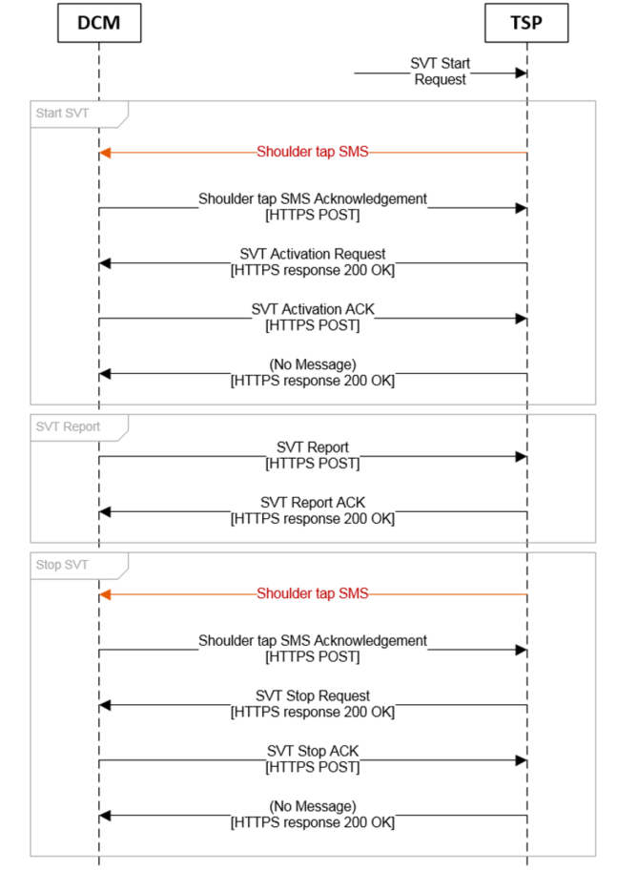
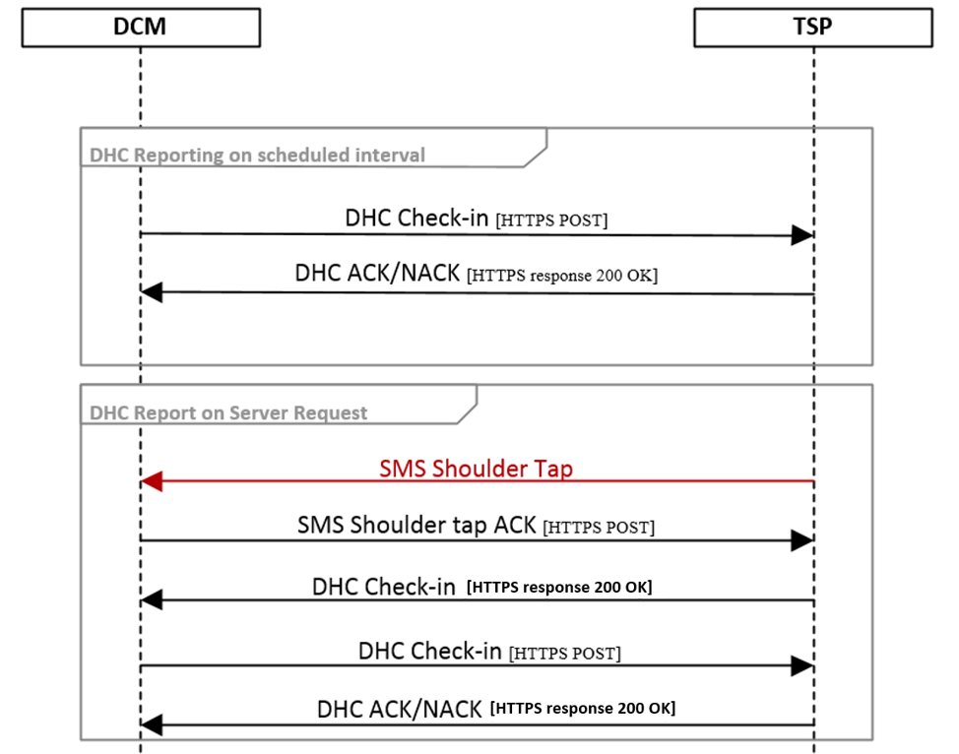
Shoulder tap SMS: receiving msg from TSP

Slide 29
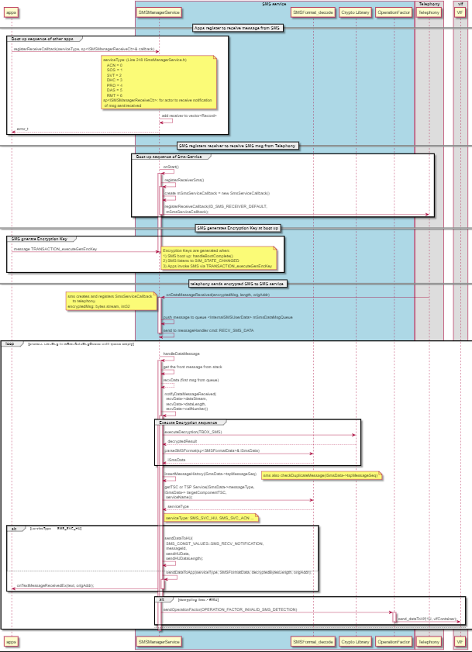
Receiving Text Message HLD
Better view at: http://collab.lge.com/main/display/~minh.pham/4.+Feature+Receiving+Message+from+TSP

Slide 30
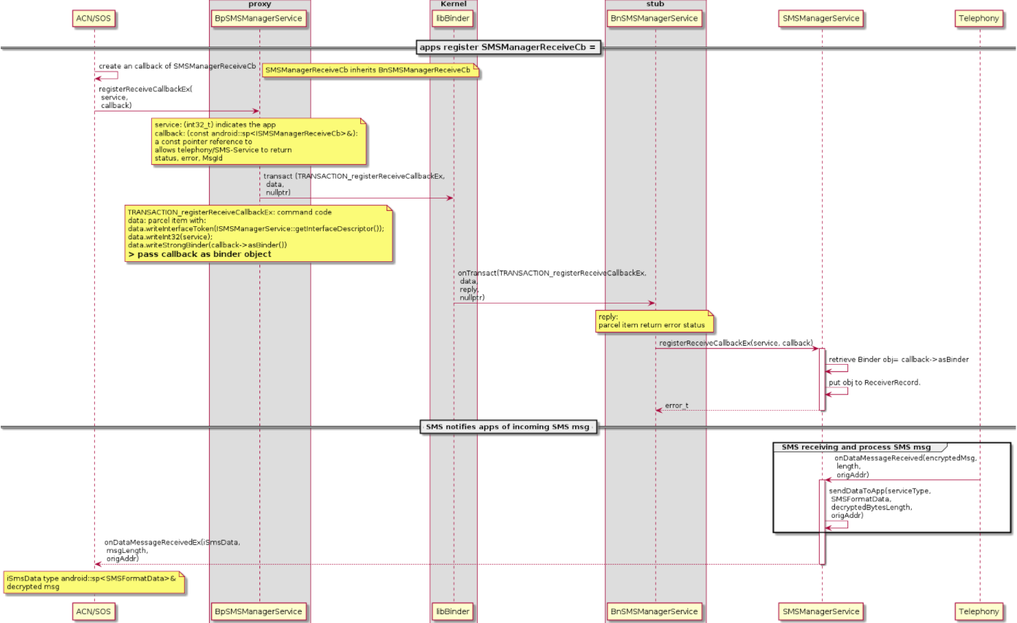
Step 1: how apps register to receive msg from SMS-Service

Slide 31
Step 1: how apps register to receive msg from SMS-Service
apps creates a receiver class that inherits BnSMSManagerReceivedCb.
apps creates an instance "receiver" of BnSMSManagerReceivedCb and register the receiver via SMSManagerService::registerReceiveCallback(serviceType, receiver)
(Same as apps call BnSMSManagerService::registerReceiverCallbackEx to register the receiver.)

Slide 32
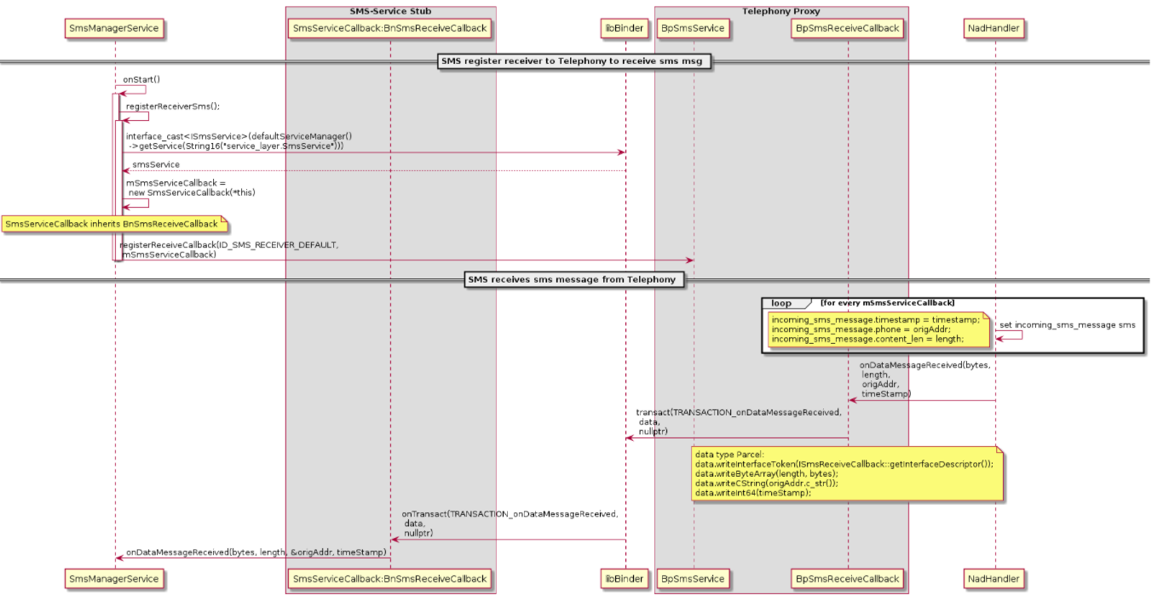
Step 2: How Sms-Service receives msg from Telephony

Slide 33
Step 2: How Sms-Service receives msg from Telephony
Sms-Service already registers Telephony::ISmsService via SMSManagerService::registerReceiverSms
Sms-Service creates a receiver class SmsServiceCallback which inheritsBnSmsReceiveCallback
Sms-Service creates an instance mSmsServiceCallback to the receiver class and register the receiver to Telephony via ISmsService::registerReceiveCallback(ID_SMS_RECEIVER_DEFAULT, mSmsServiceCallback)
Sms-Service has already registered Telephony::IPhoneStateListener and Telephony notifies SIM_STATE_LOADED ==> crypto makes encryption key. The encryption key is used for decryption

Slide 34
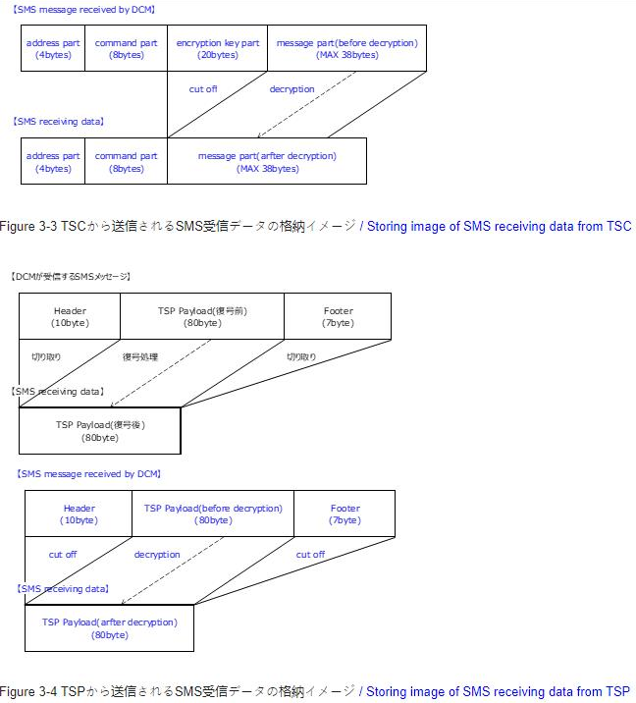
SMS Format for Received Messages
Resource: http://vscb.lge.com:8080/cb/issue/13222434
2 types of Messags:
SMS message from TSC ➔ handled by onCbMessageReceived sequence
SMS message from TSP ➔ handled by onDataMessageReceived

Slide 35
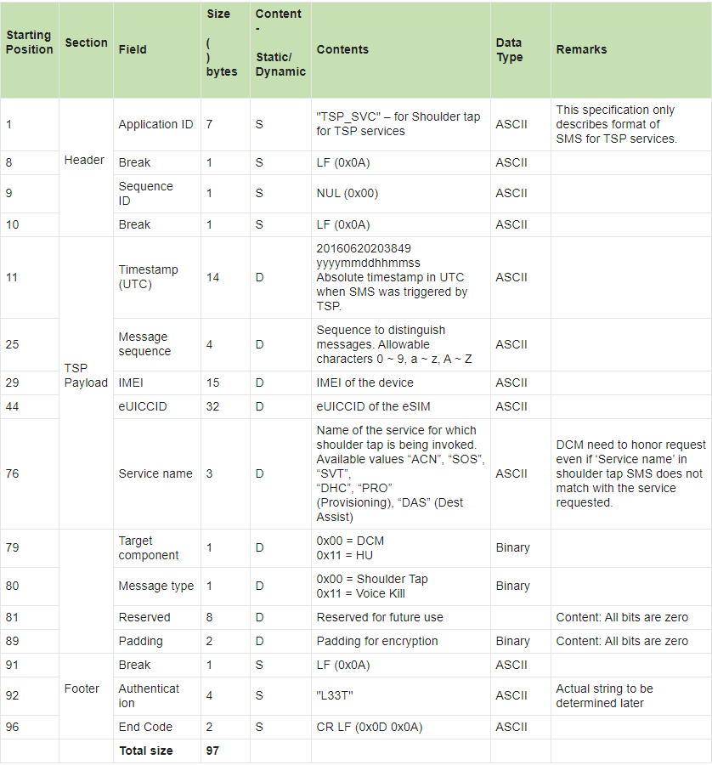
SMS Format for Received Messages
Every message from TSC has address part, command part, encryption part, and message part. ==> messages from TSC are handled in sequence: onCbMessageReceived.
Every message from TSP has header, payload, footer ==> messages from TSC are handled in sequence: onDataMessageReceived
The contend of header, payload, footer are as below:

Slide 36
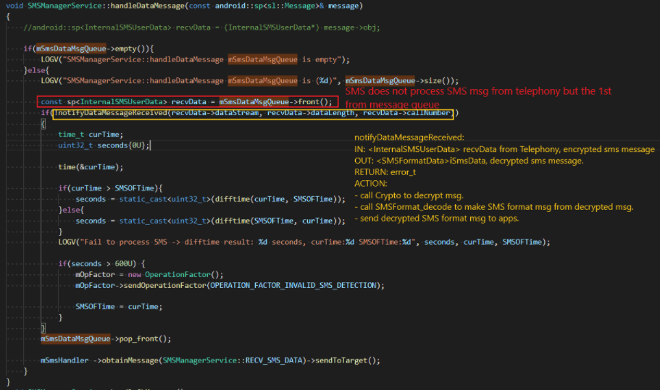
Step 12: Handling messages from Telephony
Msg is delivered as byte stream.
Msg is put into queue.
Sms-Service doesn’t return response to Telephony.
Request to handle message is sent to Binder.
Sms-Service continuously handle message until queue (size = 10) is empty.

Slide 37
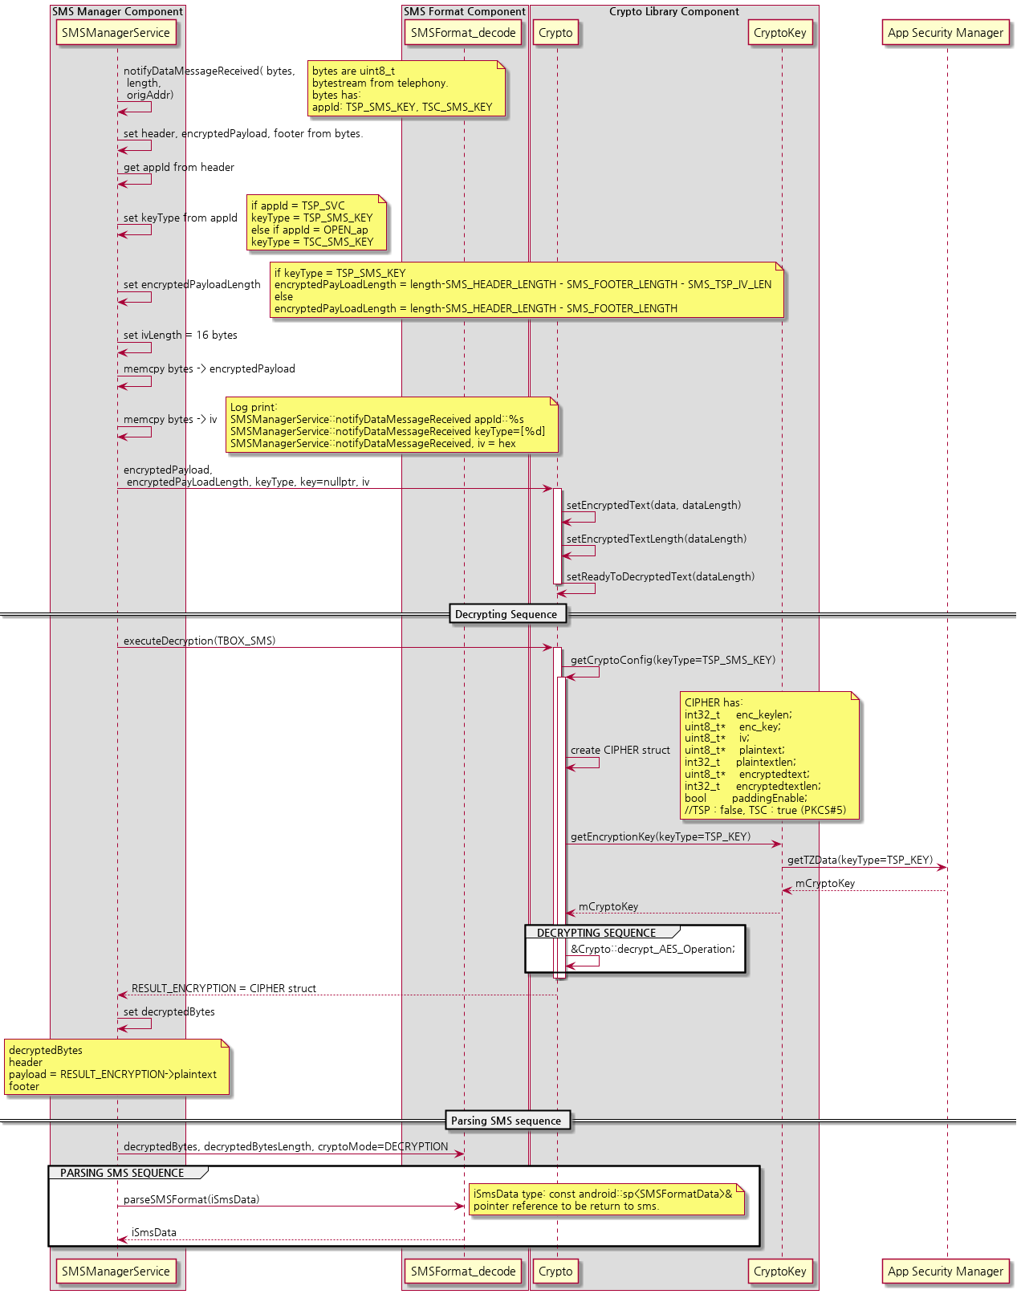
Step 16-19: Decrypting message sequence

Slide 38
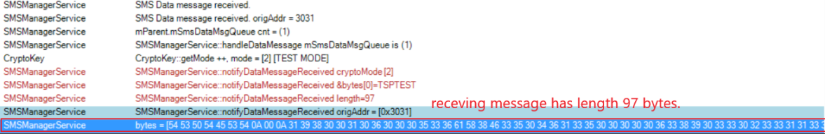
Log Reading
Receiving encrypted message from Telephony:

Slide 39
Other RS for “receive SMS feature”
RS | Description | Implementation
[RS-14324703] (US)Shoulder tap SMS Processing Requirements DCM-STS01 | Message Sequence Allowable range of characters from TSP for this field 0 9, a z, A Z. Given the four character length of this field, the content could be one of the 14776336 combinations. DCM shall maintain a history of the sequence numbers along with timestamp extracted from SMS. The size of the history buffer shall be three entries. If the sequence # of SMS just arrived already exists in the history, then discard the SMS message. Else store the sequence # (store up to three entries in the history and then overwrite the oldest after that).
DCM-STS02 | DCM shall reject a SMS if this timestamp if it is older or newer than the current time by more than 10 minutes
DCM-STS03 | DCM shall reject the SMS if the IMEI does not match the DCM’s (incorrect destination)
DCM-STS04 | DCM shall reject the SMS if the eUICC-ID does not match the DCM NAD’s (incorrect destination)
DCM-STS05 | DCM shall use the service name parameter for service prioritization purposes (Service prioritization requirements are defined in the protocol document and other DCM specifications)

Slide 40
Other RS for “receive SMS feature”
RS | Description | Implementation
DCM-STS06 | DCM shall reject the SMS if this field (authentication) does not match the static value mentioned in the SMS format specification
DCM-STS07 | DCM shall decrypt the “TSP Payload” section based on encryption algorithm details described below in section 4
DCM-STS08 | Upon receiving a SMS with “Message type” 0x00 and target component 0x00, DCM shall initiate a Shoulder Tap acknowledgement message to TSP
DCM-STS09 | Upon receiving a SMS with “Message type” as 0x00 and target component 0x11, DCM shall wake up and inform HU so HU can initiate a Shoulder Tap acknowledgement message to TSP
DCM-STS10 | Upon receiving a SMS with “Message type” as 0x11 and target component 0x00, DCM shall terminate the ongoing voice call
DCM-STS11 | DCM shall allow buffering of maximum 10 valid SMS when DCM is processing a Shoulder tap acknowledgement message to TSP

Slide 41
Summary
Encryption Keys are created at boot up.
Sending Messages
Messages are encrypted by Crypto Library before sending to SMS service
Messages are sent by SMS service to Tiger platform and RIL
RIL sent message to destination
Receiving
Messages are received by SMS service
Messages are sent to Crypto Library for decryption
Messages are then sent to apps

Slide 42
Process at Telephony Size
Discussion on Telephony Action

Slide 43
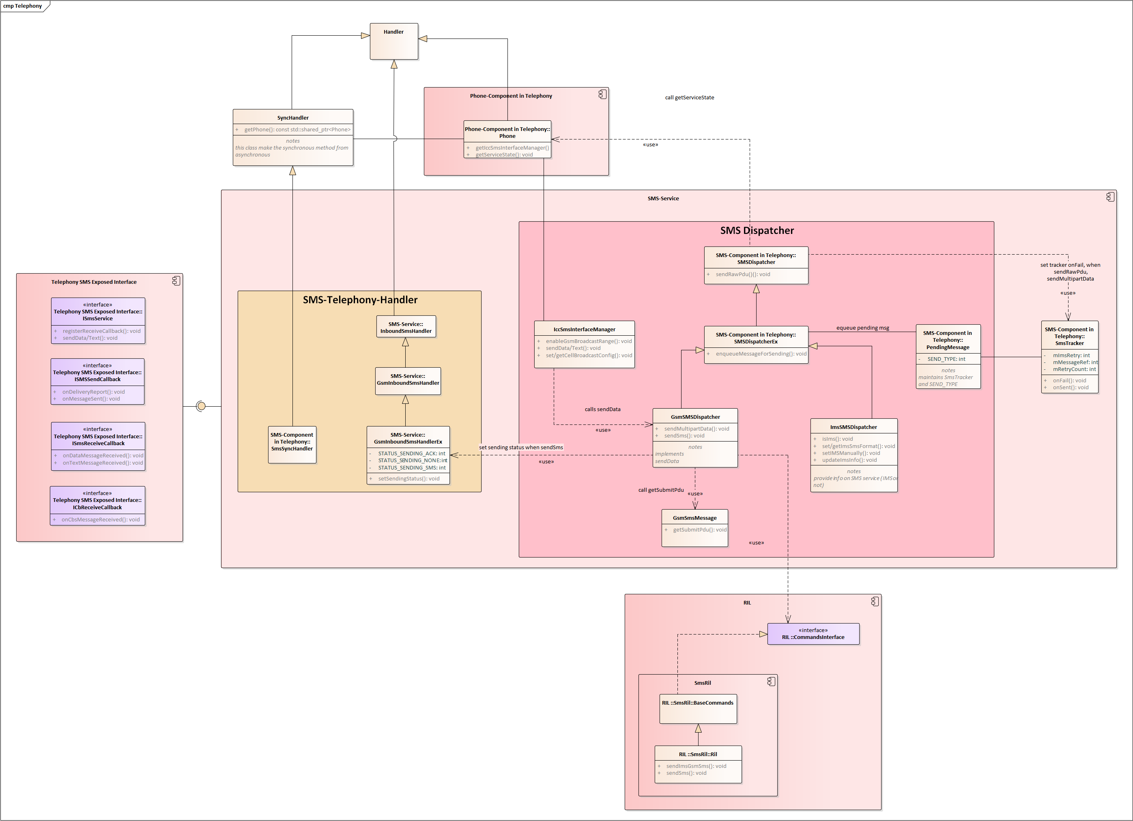
Telephony Component

Slide 44
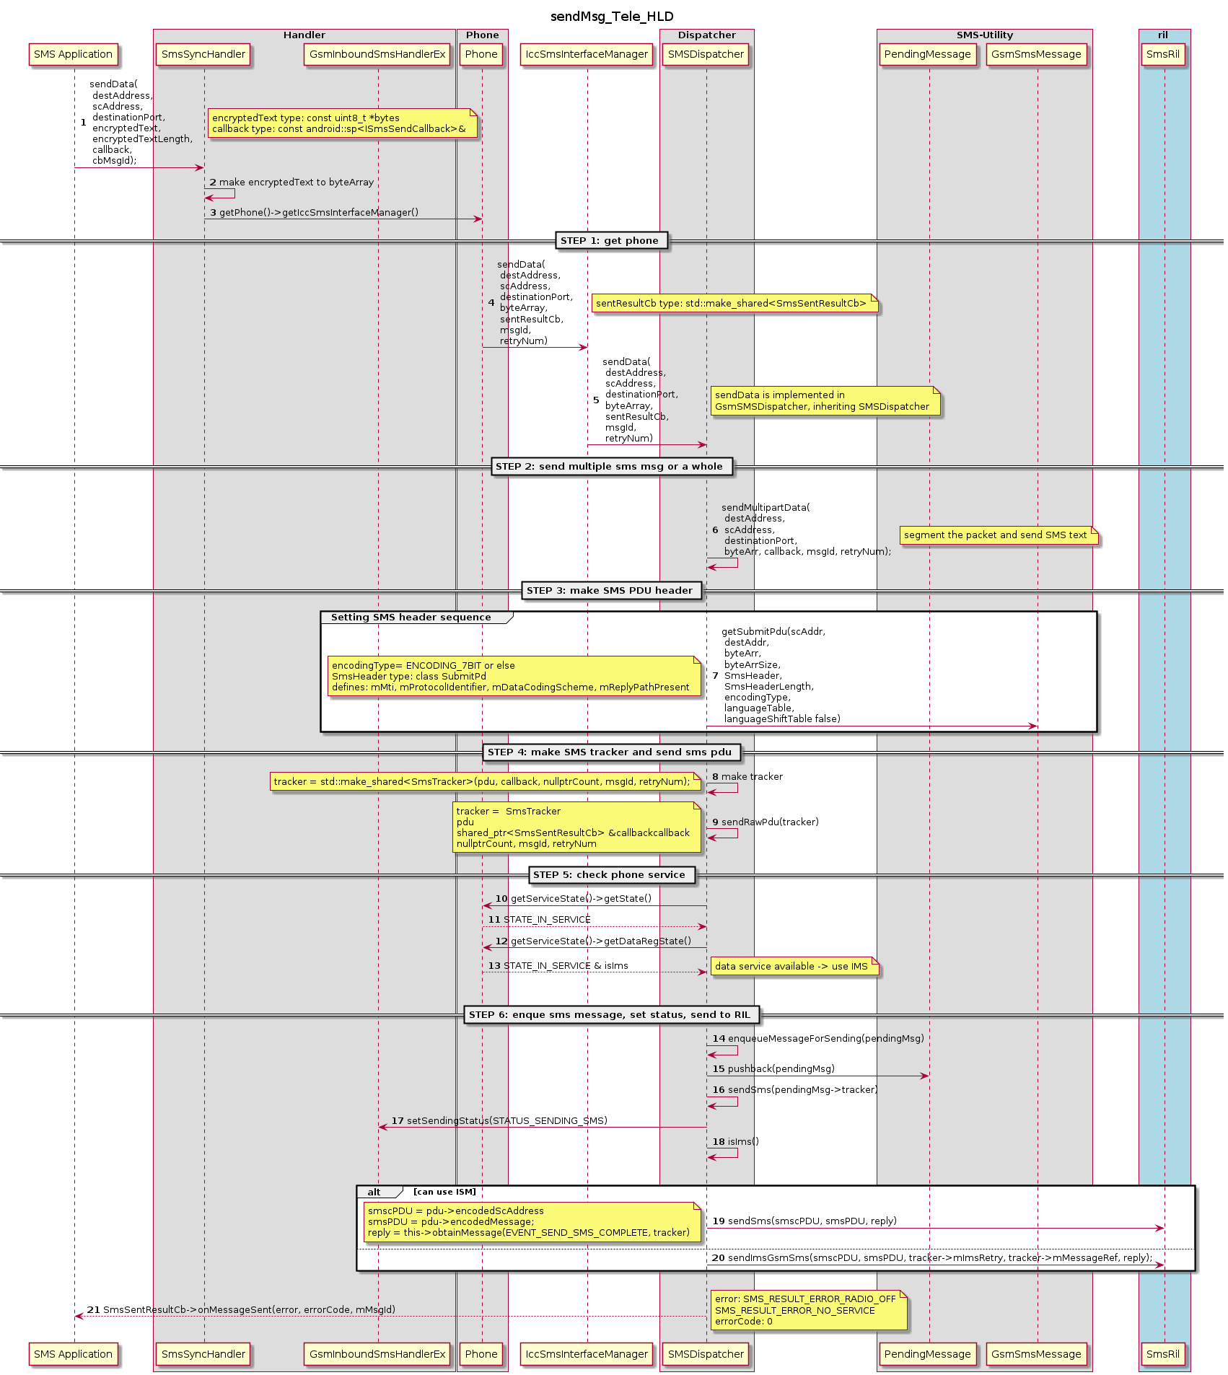
Telephony::sendData

Slide 45
Telephony::sendData
PREREQUISITES:
Phone service is STATE_IN_SERVICE ➔ how is it set/retrieved?
SMS profile has IMS availability ➔ how is it set/retrieved?
SMS event EVENT_SEND_SMS_COMPLETE ➔ how is it achieved ?
How sms message was wrapped and delivered to RIL? ➔ via need to recheck code.

Slide 46
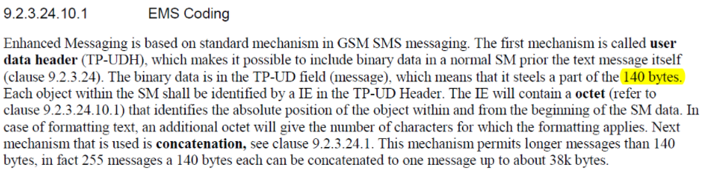
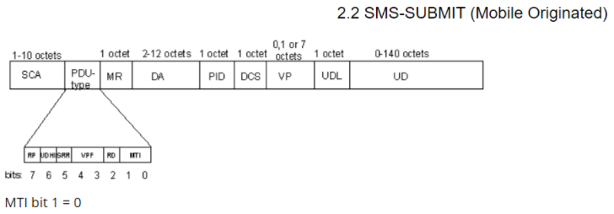
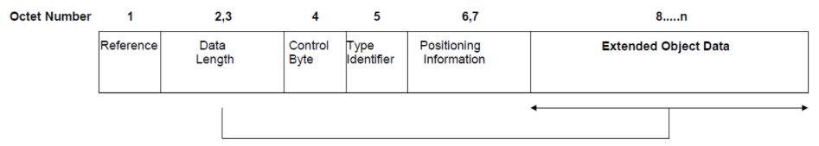
SMS-SUBMIT (MO SMS msgs)

Slide 47
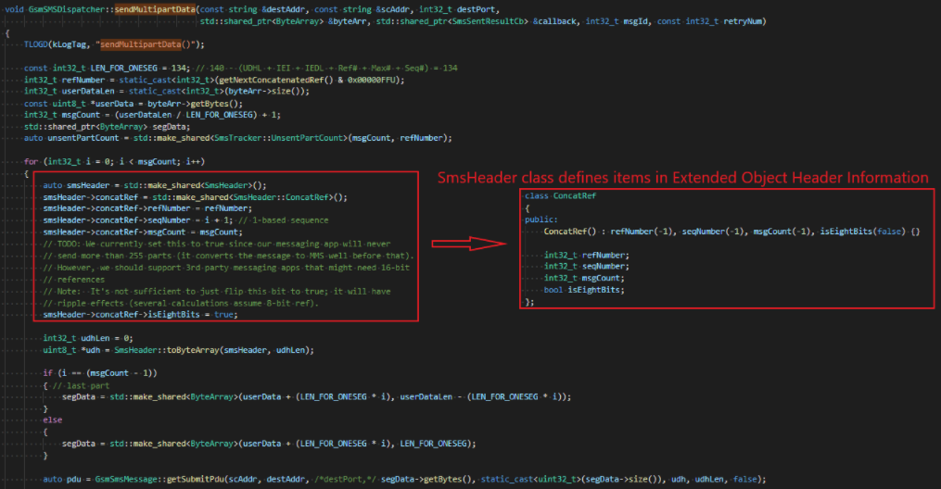
telephonyMultipartData

Slide 48
Summary
Telephony job is to make SMS PDU section in accordant to 3GPP 38.040
Telephony doesn’t perform SMS Compression
Telephony doesn’t actually send SMS message out to internet but send to RIL

Slide 49
Last words…
More details also provided in my collab page: http://collab.lge.com/main/display/~minh.pham/TBOX-19MC
Coming next: operation at Telephony side
What is still missing ? Processing SMS message from TSC !
THANK YOU

